Slide 1
ADP Coursework 2 Presentation
Presented by Group 3 -
Muskan Asmath - K2279003
Arya Pradeep Menon- K2275592
Shahesta Ahmed- K2283306
Bhavana Koppula- K2278142

Slide 2


IDA (Initial Data Analysis)
Data Collection
Data Cleaning
Rename Attribute Names
Drop Features and Records
Check Duplicates
Handling Missing Values
Datatype Modification
Data Transformation
Detecting Outliers

Slide 3
EDA (Exploratory Data Analysis)
Descriptive Statistics
Histograms
Count-plots
Correlation Matrix
Rounding to 2 decimal places

Slide 4
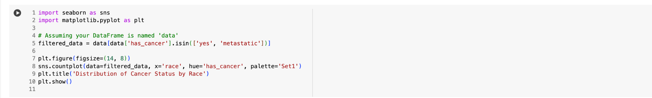
Distribution of Cancer Status by Race

Slide 5
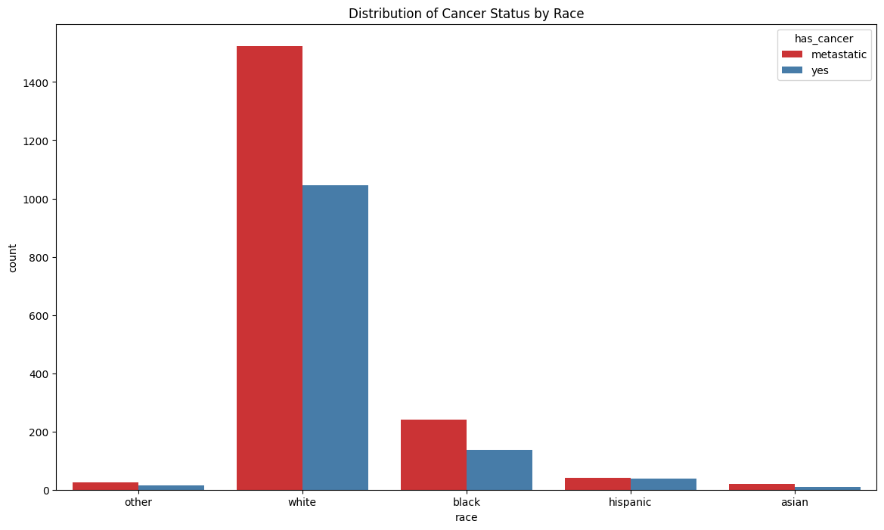

Slide 6
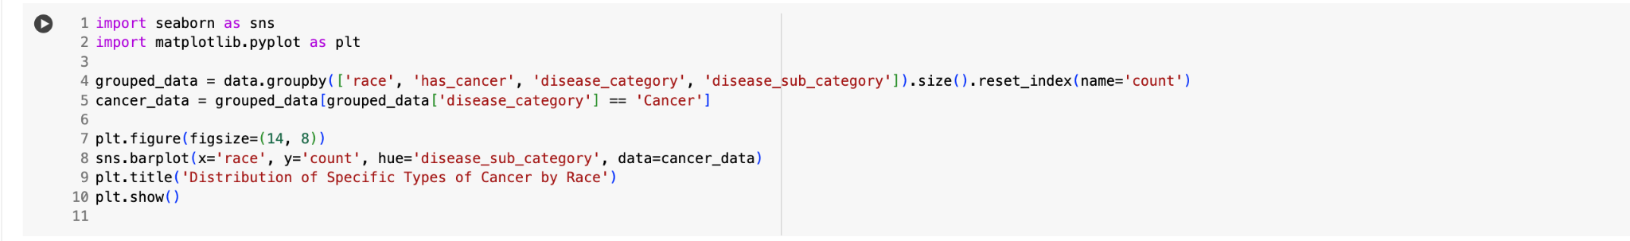
Distribution of Specific Types of Cancer by Race

Slide 7
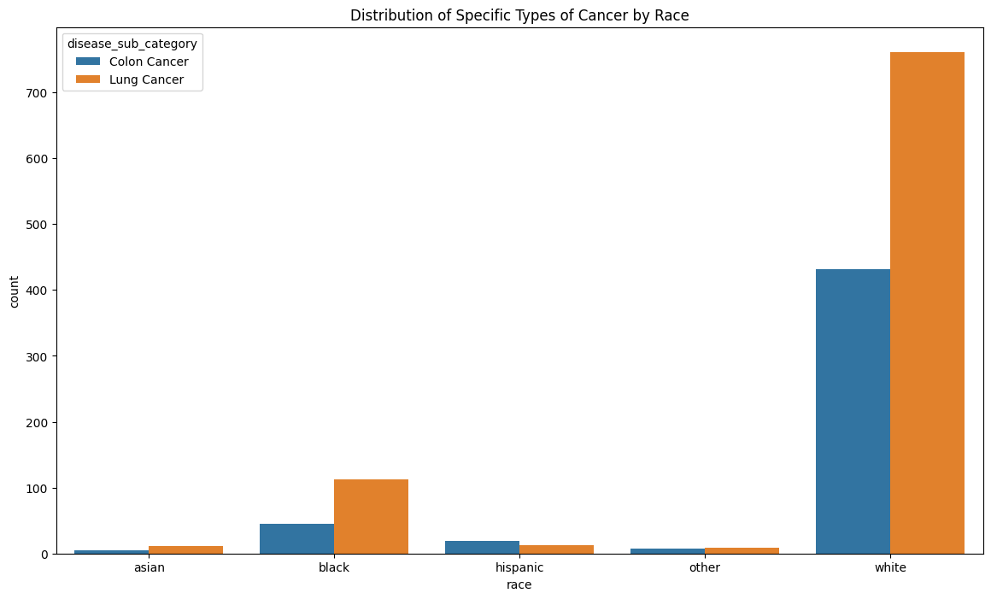

Slide 8
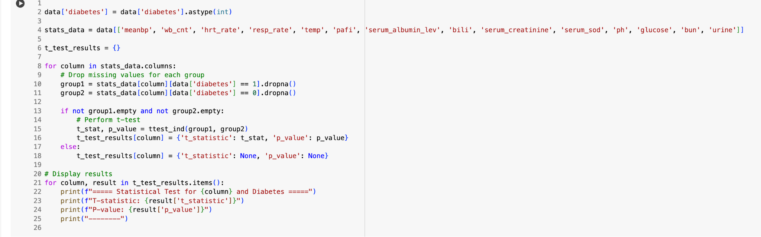
Checking if certain columns play a significant role in determining if a patient has diabetes

Slide 9
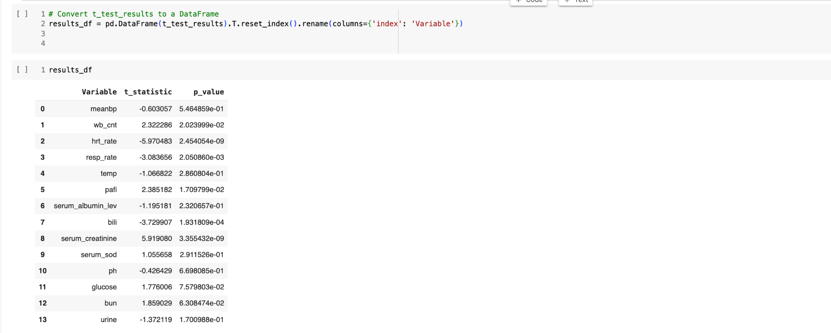
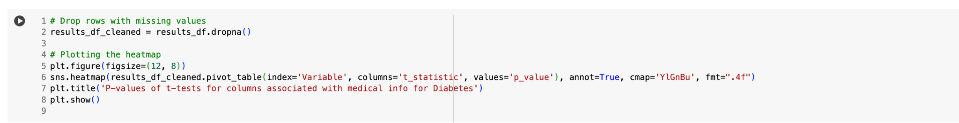
Converting t_test_results to results_df dataframe

Slide 10
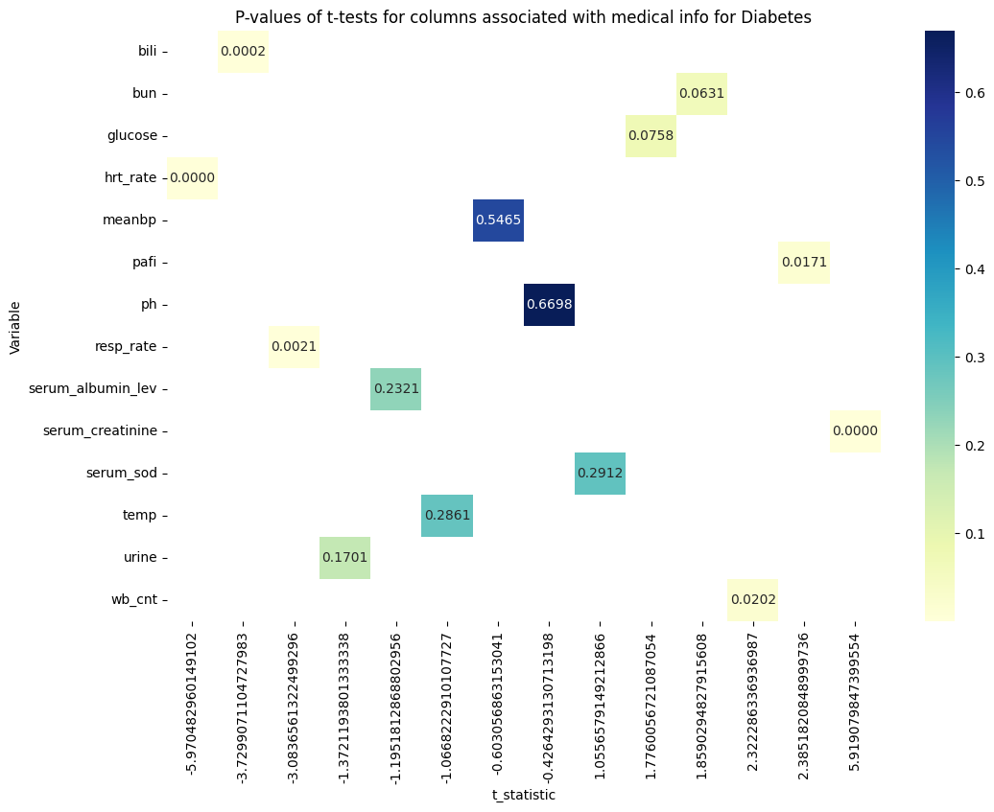

Slide 11
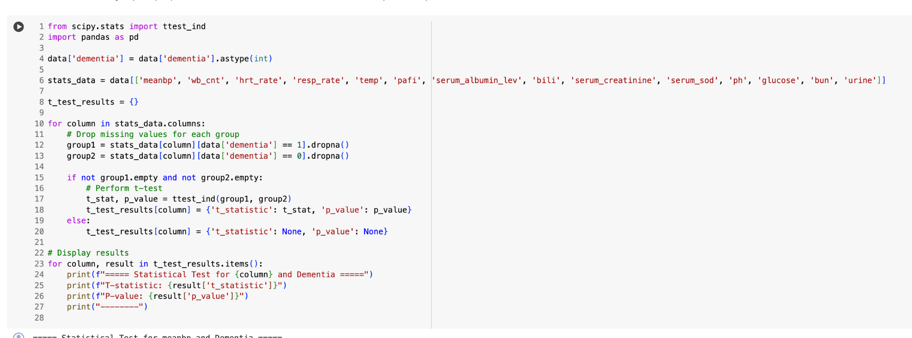
Checking if certain columns play a significant role in determining if a patient has Dementia

Slide 12
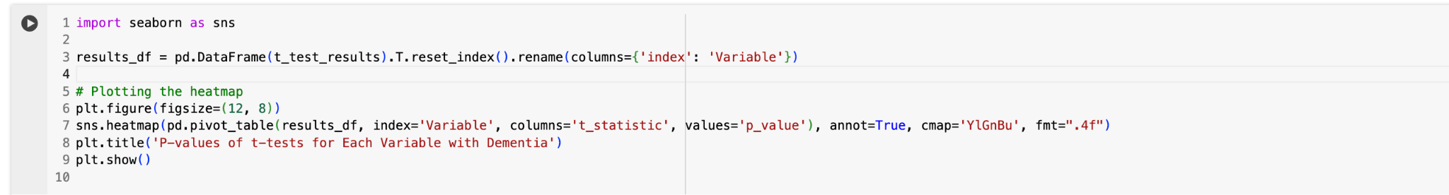
Converting t_test_results to results_df dataframe

Slide 13
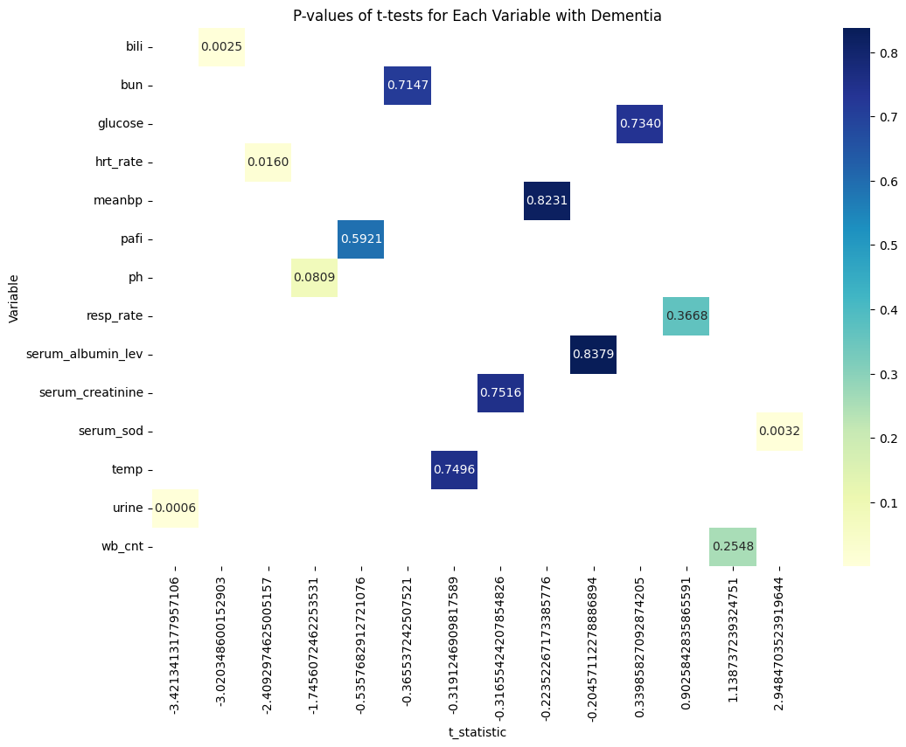

Slide 14
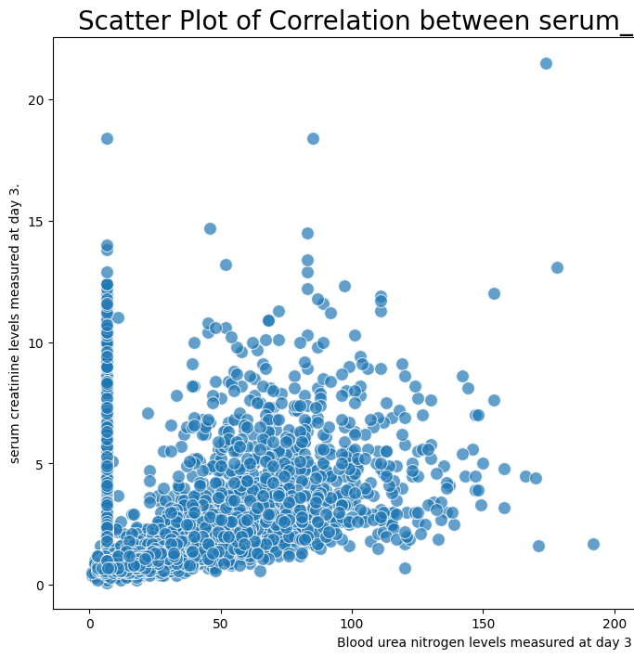
Correlation between serum creatinine and BUN(Blood urea nitrogen levels):
CODE snippet:
sns.scatterplot(x='bun', y='serum_creatinine', data=df, palette='muted', s=100, alpha=0.7)
There is a moderate positive linear correlation between the two variables of BUN and SCr.
Notes:
BUN and SCr are important tools for diagnosing kidney disease. High levels of BUN and SCr can be a sign of kidney damage, and they can also be used to monitor the progression of kidney disease over time. This is because both BUN and SCr are measures of waste products in the blood that are produced by the breakdown of protein.
This means that as BUN levels increase, SCr levels also tend to increase.

Slide 15
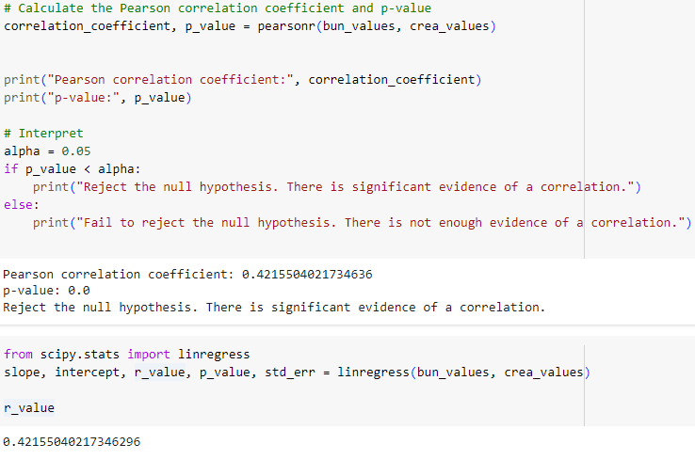
P-test and Pearson correlation coefficient
Null Hypothesis (H0): There is no correlation between 'bun' and 'serum_creatinine'.
Alternative Hypothesis (H1): There is a correlation between 'bun' and 'serum_creatinine'.
Notes:
The ‘scipy.stats’ module provides a function called pearsonr to calculate Pearson correlation coefficient and its associated p-value . the p-value is a measure that helps assess the evidence against a null hypothesis.
Therefore, there is strong evidence to suggest that there is a statistically significant correlation between 'bun' and 'serum_creatinine'.
Since the p-value is 0, we would reject the null hypothesis in favor of the alternative hypothesis
The strength of the correlation is moderate, as indicated by the correlation coefficient of 0.42
The Pearson correlation coefficient measures the strength and direction of a linear relationship between two variables. It ranges from -1 to 1

Slide 16
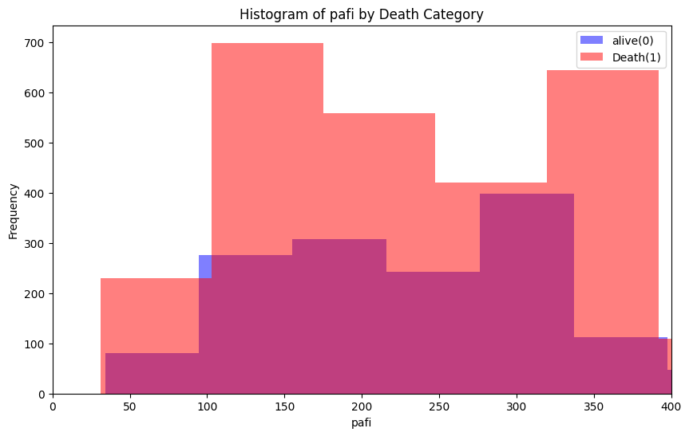
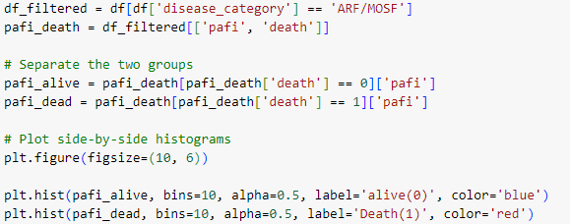
Is there an association of PAFI values with mortality? Is there any association in patients having respiratory diseases.
PaO2/FiO2 ratio is the ratio of arterial oxygen partial pressure (PaO2 in mmHg) to fractional inspired oxygen.
ARDS Severity PaO2/FiO2 Mortality
Mild 200 – 300 27%
Moderate 100 – 200 32%
Severe < 100 45%
Notes:
PaO2/FiO2 ratio is the ratio of arterial oxygen partial pressure (PaO2 in mmHg) to fractional inspired oxygen (FiO2 expressed as a fraction, not a percentage).
by visualizing the data by separating it into two groups based on the 'death' category (alive or dead) and created side-by-side histograms to visualize the distribution of PAFI values for each group.
There is an association between PAFI values and mortality, and the results of the statistical test and visualization provide evidence regarding the presence in patients having respiratory diseases.
ARDS (Acute Respiratory Distress Syndrome)

Slide 17
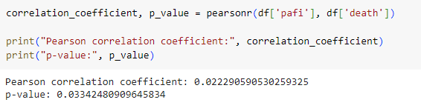
Pearson's Correlation Coefficient
The correlation between PAFI (Pulmonary Arterial Flow Index) values and the likelihood of death(Mortality) can be found by the Pearson's Correlation Coefficient test.
As the p-value is less than the significance level of 0.05, the null hypothesis is rejected. Hence, there is a significant correlation between PAFI values and the death rate in patients having respiratory diseases.

Slide 18
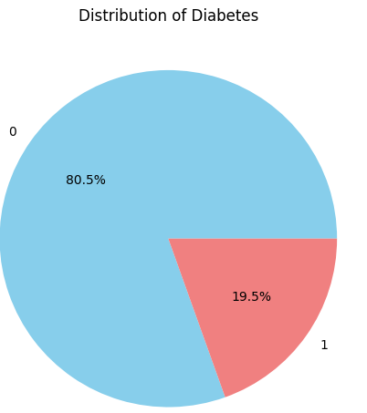
Data distribution of glucose levels across ages with and without diabetes
This visualization was to observe the trend of the number of non-diabetic increasing glucose levels.
However, due to the higher number of non-diabetic cases, the data is not normally distributed.
For visualization, age groups of 10 years from ‘0-10’ to ‘above 80’ were created and used in the boxplot for data distribution.

Slide 19
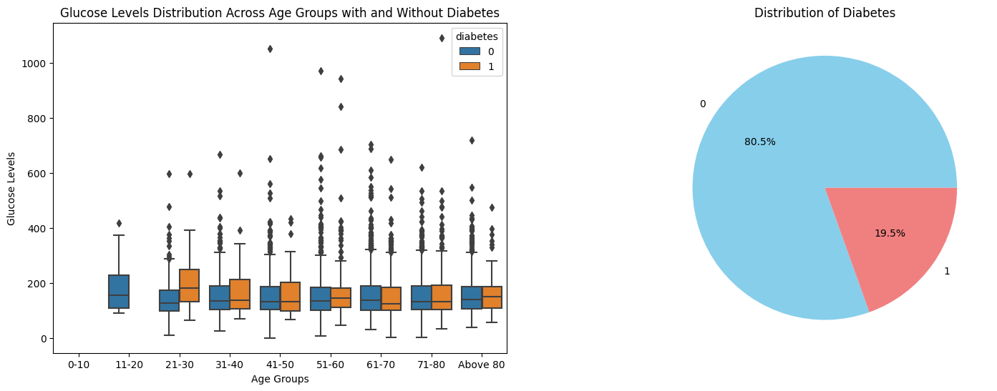
Code snippet:
sns.boxplot(data=df, x='age_group', y='glucose', hue='diabetes', ax=ax1)
INFERENCE:
The patients with diabetes have higher range of values and median of glucose values.
As the age group increases this difference in median is decreasing which suggests the are other factors that affect diabetes in older groups >50 years.
In general, patients with diabetes have higher glucose levels, that is, their IQR range are higher comparatively.

Slide 20
Distribution of Average TISS Score Across Disease Subcategories
Therapeutic Intervention Scoring System (TISS) is a method for calculating costs in the intensive care unit (ICU) and intermediate care unit (IMCU).
Code snippet of boxplot:
sns.boxplot(data=df, x='disease_sub_category', y='avg_tiss_score’, palette='viridis')

Slide 21
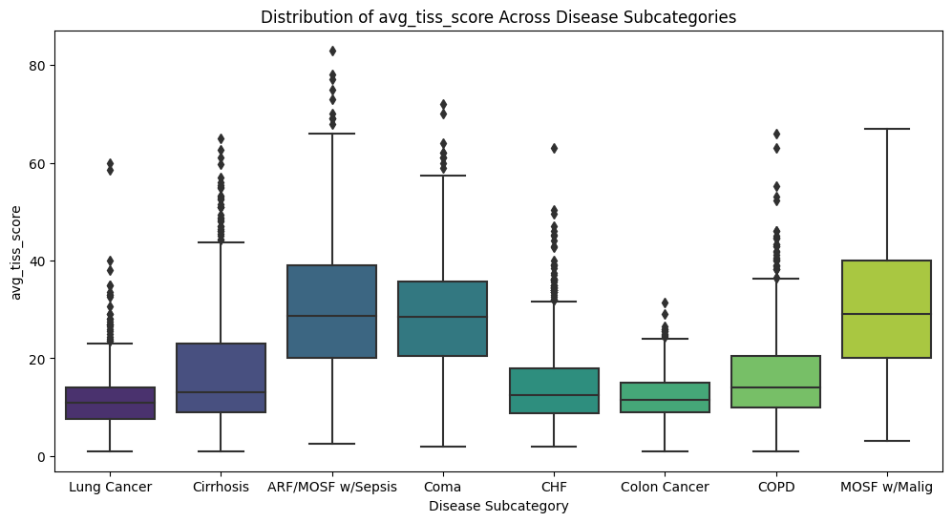
INFERENCE:
From the above graph, the Average TISS score of Cancer: lung and colon has low values which show that the costs in the intensive care unit (ICU) and intermediate care unit (IMCU) are lower for such patients.
High Tiss score shows more costs are incurred by patients suffering from ARF/MOSF w/Sepsis, Coma and MOSF w/Malig.
Notes:
Acute Respiratory Failure (ARF), Coma, and Multiple Organ System Failure (MOSF) intensive level of care can significantly contribute to higher costs.
Length of Hospital Stay:
Use of Life-Support Systems and specilized meds.

Slide 22
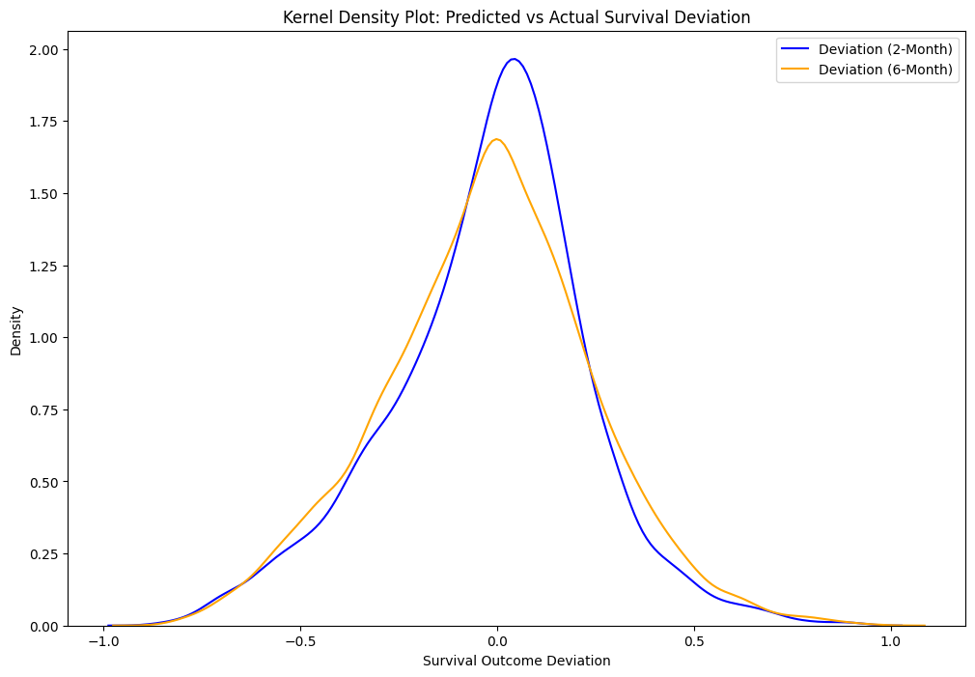
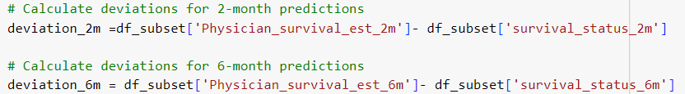
Deviation of predicted physician's survival score vs actual survival score for both 2 and 6 months

Slide 23
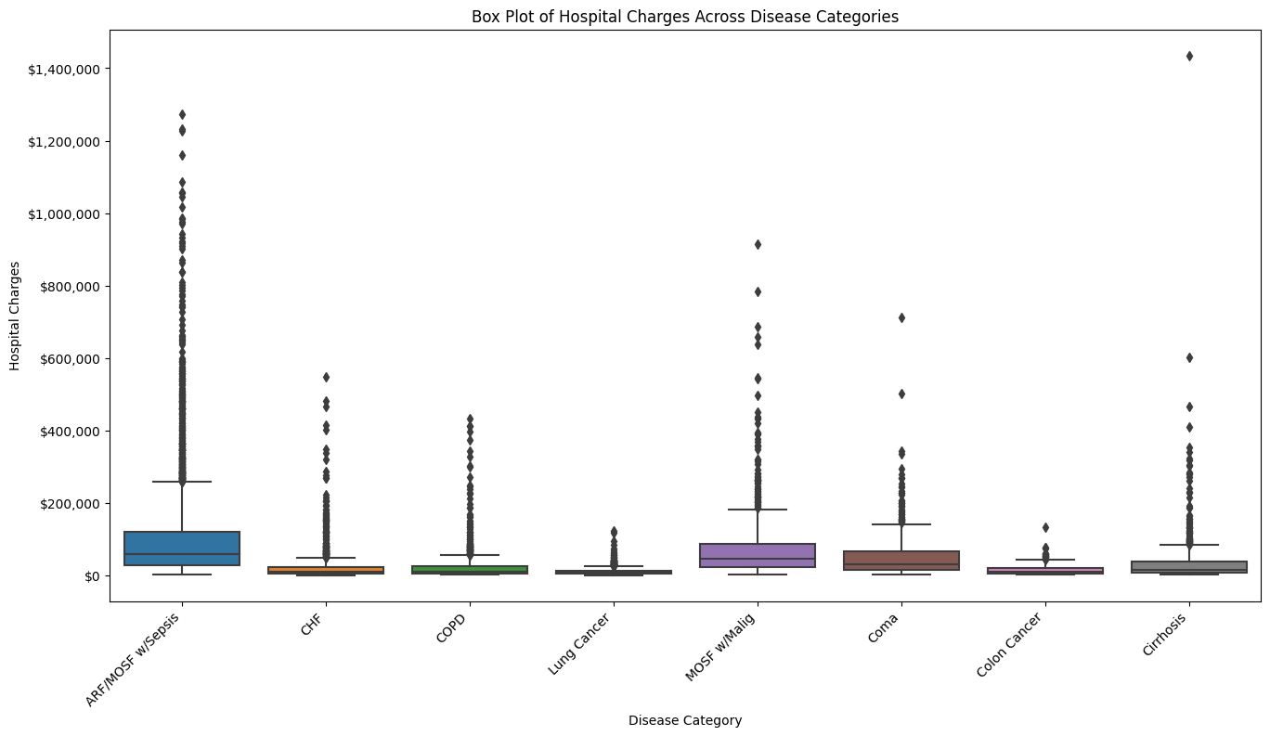
Hospital Charges Across Disease Categories
Higher Cost Charge variability:
ARF/MOSF w/Sepsis
MOSF w/Malig
Coma
Least Cost Charge variability:
Lung Cancer
Colon Cancer

Slide 24
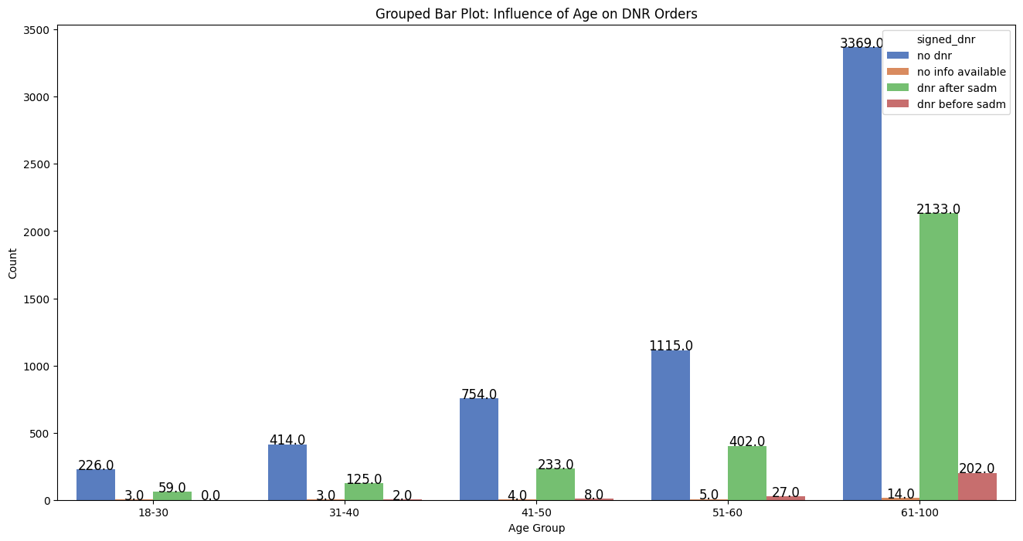
Exploring the Influence of Age on Do Not Resuscitate (DNR) Orders
Age Group 0-30 has the lowest DNR percentage.
Older age groups (51-60 and 61-100) show higher percentages, indicating a preference for non-resuscitative measures.

Slide 25
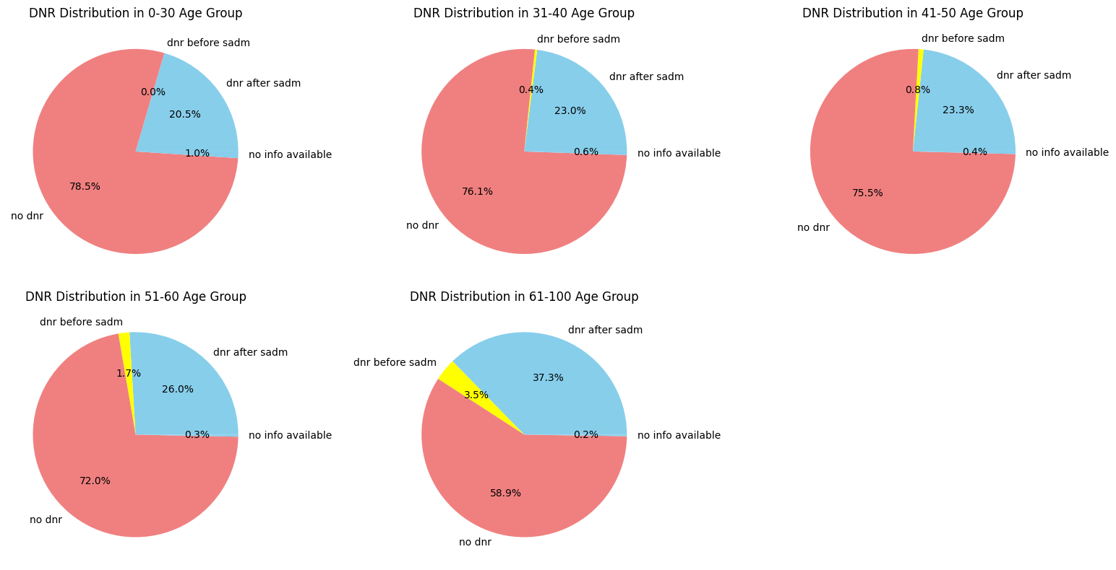

Slide 26
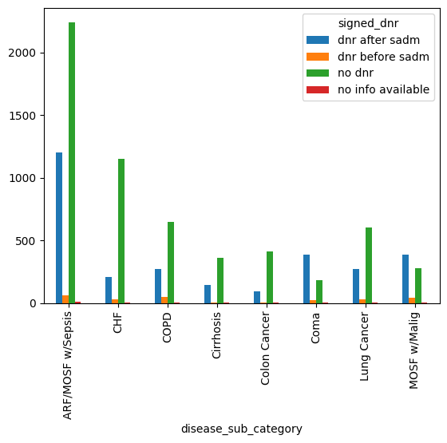
Association between DNR and disease categories

Slide 27
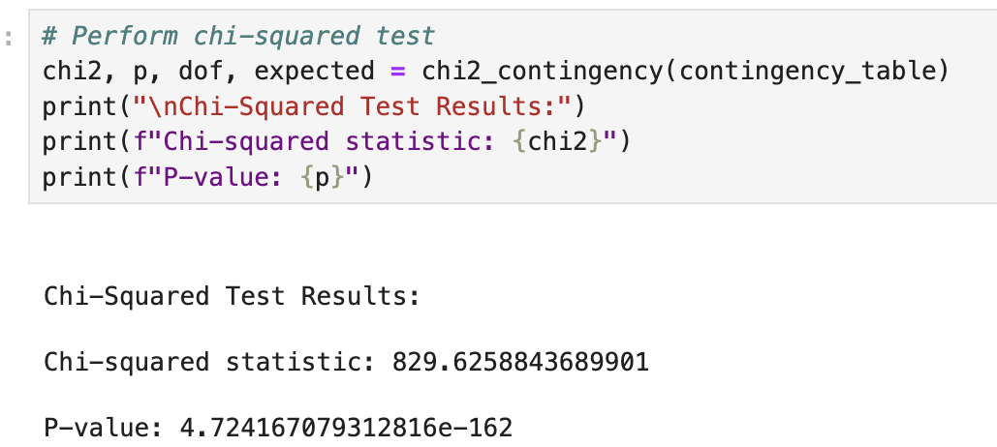
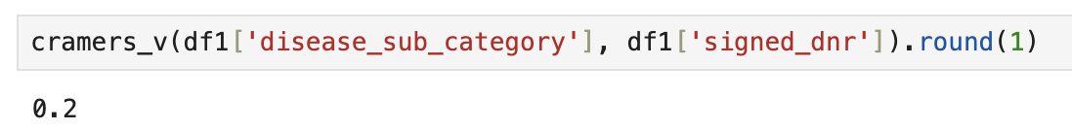
Null Hypothesis (H0): There is no association between ‘disease_sub_category' and ‘signed_dnr’ in the population.​
Alternative Hypothesis (H1): There is an association between ‘disease_sub_category' and ‘signed_dnr’ in the population.

Slide 28
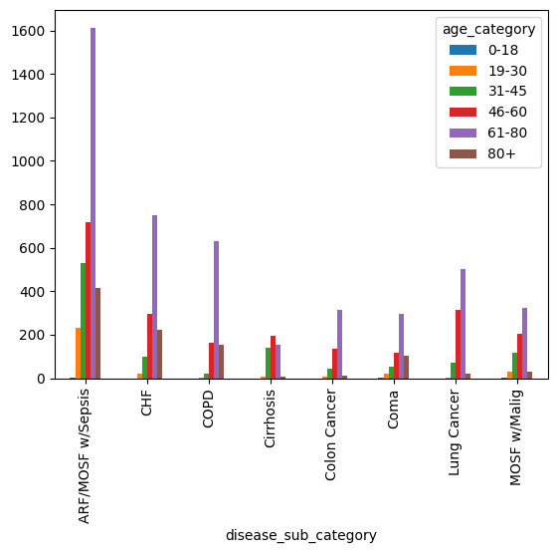
Association between disease and age categories

Slide 29
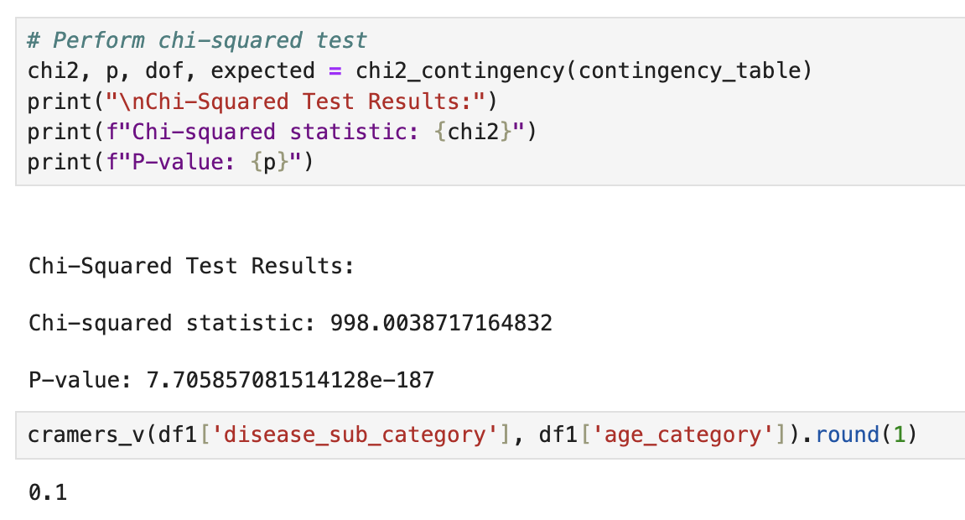
Null Hypothesis (H0): There is no association between ‘disease_sub_category' and ‘age_category' in the population.​
Alternative Hypothesis (H1): There is an association between ‘disease_sub_category' and ‘age_category' in the population.

Slide 30
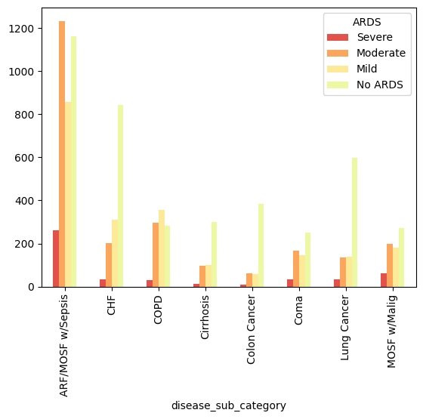
Presence of Acute Respiratory Distress Syndrome (ARDS) across different diseases
ARDS Severity PaO2/FiO2
No ARDS >300
Mild 200 – 300
Moderate 100 – 200
Severe < 100
INFERENCE:
Most severe values observed in ARF/MOSF w/Sepsis and COPD.
Notable presence of ARDS in various diseases
These diseases might have some impact on respiratory system

Slide 31
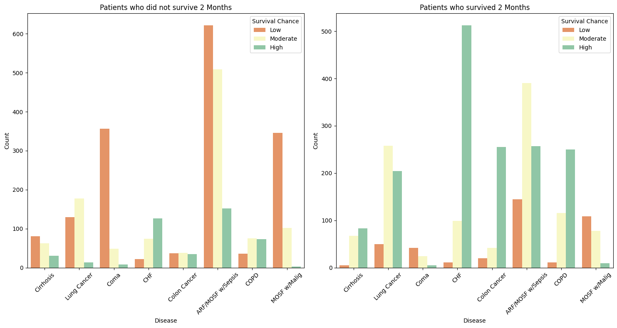
SUPPORT model efficiency in predicting survival status
Survival Status Survival Chance
>0.75 High
>0.5 Moderate
<=0.5 Low

Slide 32
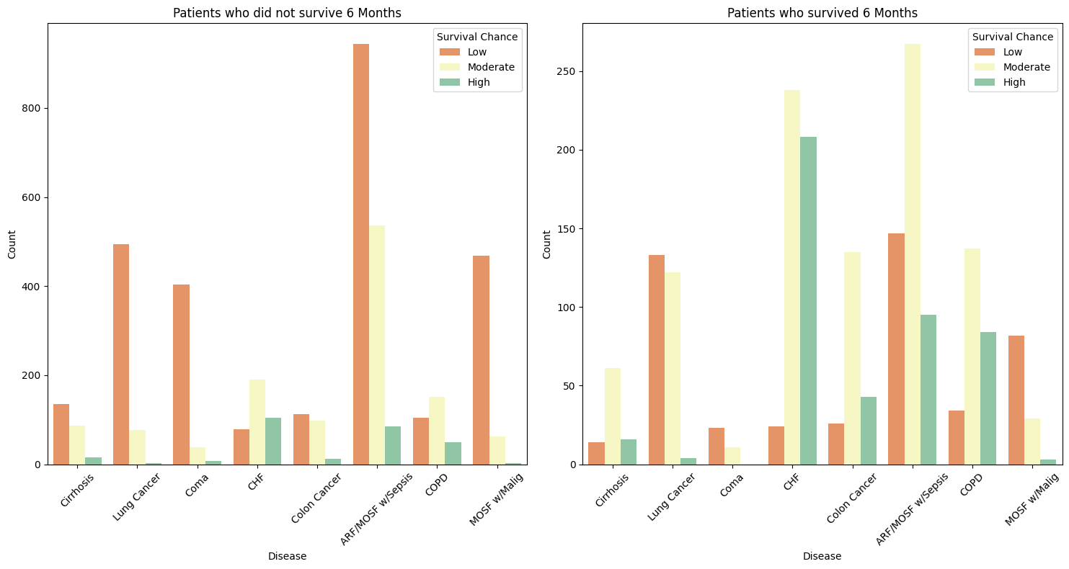
INFERENCE:
Effective prediction for survival and non-survival
Exceptions
Non Survival - CHF, Colon Cancer and COPD
Survival - Lung Cancer, Coma, ARF/MOSF w/Sepsis and MOSF w/Malig

Slide 33
Conclusion :
Outliers are retained as potential special cases.
Imbalances and biases exist, with notable disparities in racial categories and disease distributions.
Successful predictions by SUPPORT model with some exceptions
Chi Squared Test Findings :
Association between serum_creatinine and BUN
Association between PAFI values and mortality
Association between diseases and age groups
Association between diseases and DNR signed
Cancer patients have lower ICU and IMCU costs, while ARF/MOSF w/Sepsis, Coma, and MOSF w/Malig incur higher costs.
Younger individuals (0-30) less likely to have DNR orders, while older individuals (61-100) show increased preference for non-resuscitative care.
T-Test Findings :
Significant differences in 'bili' and 'hrt_rate' for groups with and without diabetes and dementia.
Recommendation :
SUPPORT model performance could be improved
Reconduct the study with latest, diverse and balanced dataset.

